Slide 1
Mbed Implementation
Filter Design
Peak Detection
Oxygenation and heart rate computation

Slide 2
Mbed Implementation
Filter Design
Implemented with mbed_dsp library
Matlab generated
47-order low pass FIR filter
FIR v.s. IIR
DC: Use a constantly updated average value

Slide 3
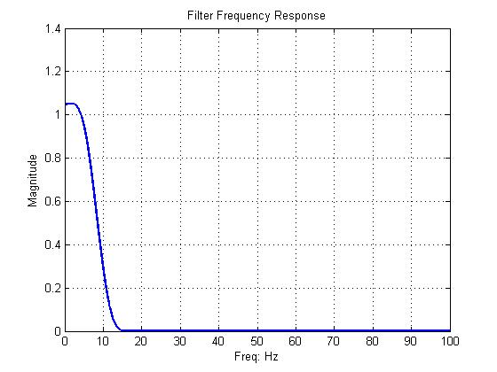

Slide 4
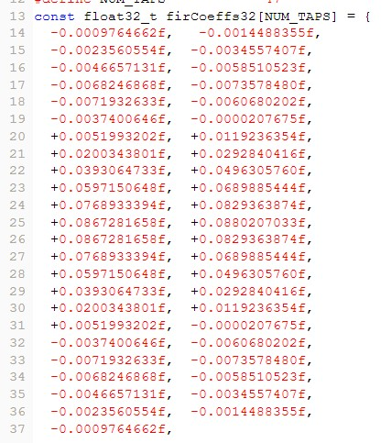

Slide 5
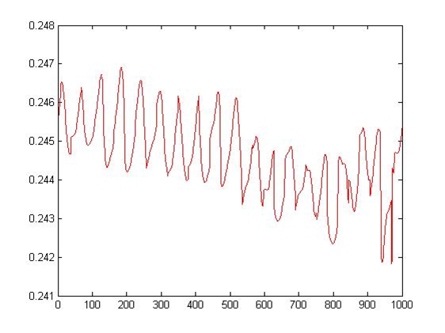

Slide 6

Mbed Implementation
Peak Detection
Simple algorithm to find local maxima
Calculate S function:
Ref: Simple Algorithms for Peak Detection in Time-Series In Proc. 1st Int. Conf. Advanced Data Analysis, Business Analytics and Intelligence (2009) by Girish K. Palshikar

Slide 7
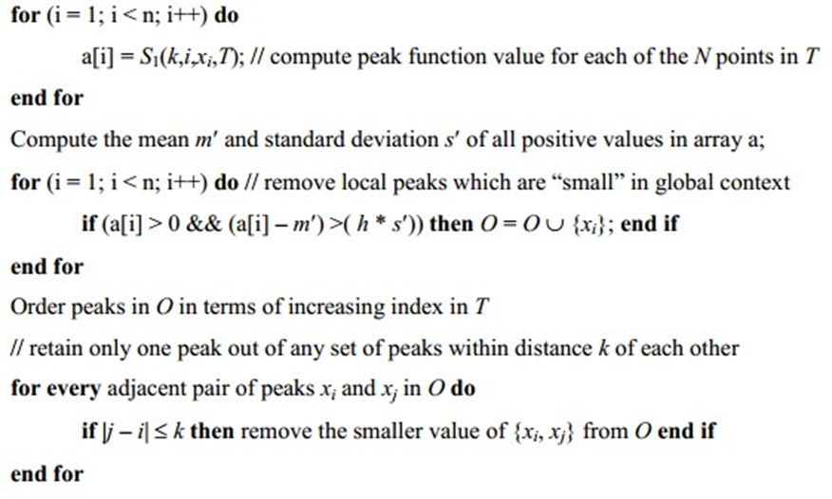
Ref: Simple Algorithms for Peak Detection in Time-Series In Proc. 1st Int. Conf. Advanced Data Analysis, Business Analytics and Intelligence (2009) by Girish K. Palshikar

Slide 8
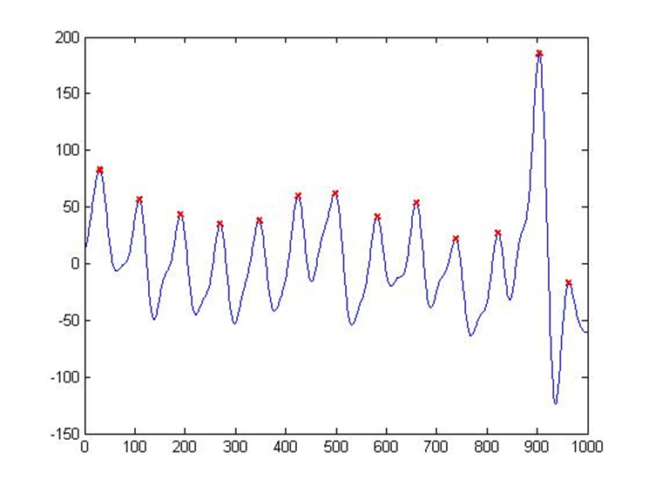
K=10, h=1

Slide 9
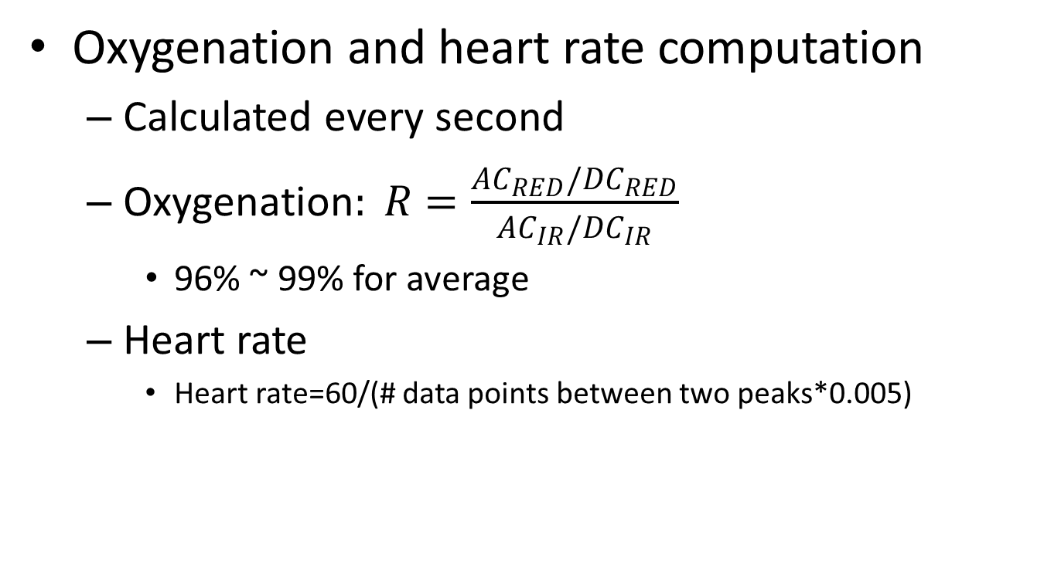
Mbed Implementation
Oxygenation and heart rate computation
Calculated every second
$\text{Oxygenation}: R=\frac{{AC}_{RED}/{DC}_{RED}}{{AC}_{IR}/{DC}_{IR}}$
96% ~ 99% for average
Heart rate
Heart rate=60/(# data points between two peaks*0.005)

Slide 10
Reference
[1] : Simple Algorithms for Peak Detection in Time-Series In Proc. 1st Int. Conf. Advanced Data Analysis, Business Analytics and Intelligence (2009) by Girish K. Palshikar

